Slide 1
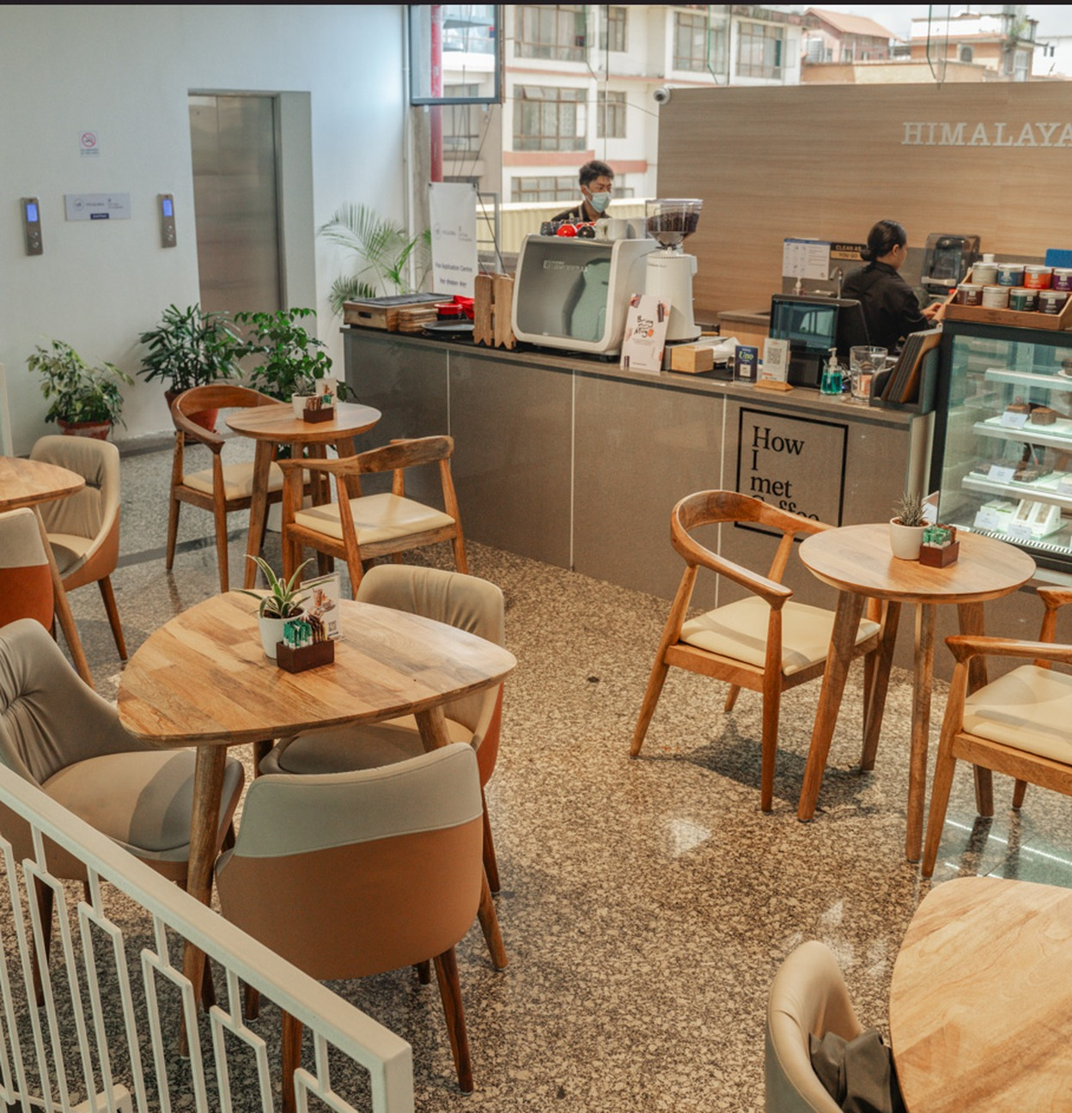

Himalayan Java

Slide 2

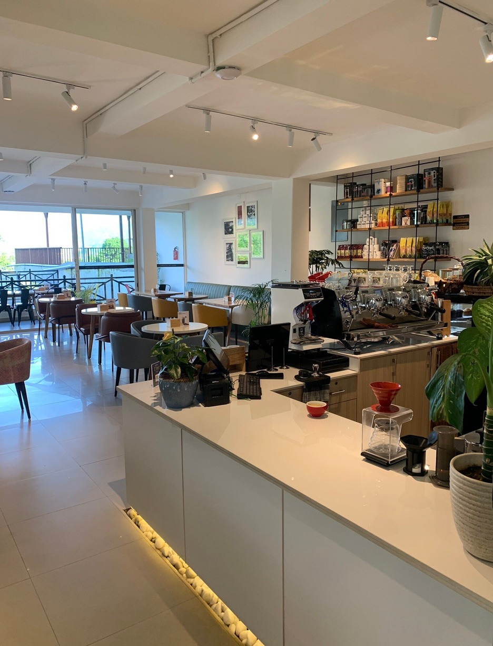
Content
1.
Introduction
2.
Company Overview
3.
Market Opportunity Analysis
4.
Marketing Mix Strategy Recommendation
5.
Conclusion
6.
References

Slide 3

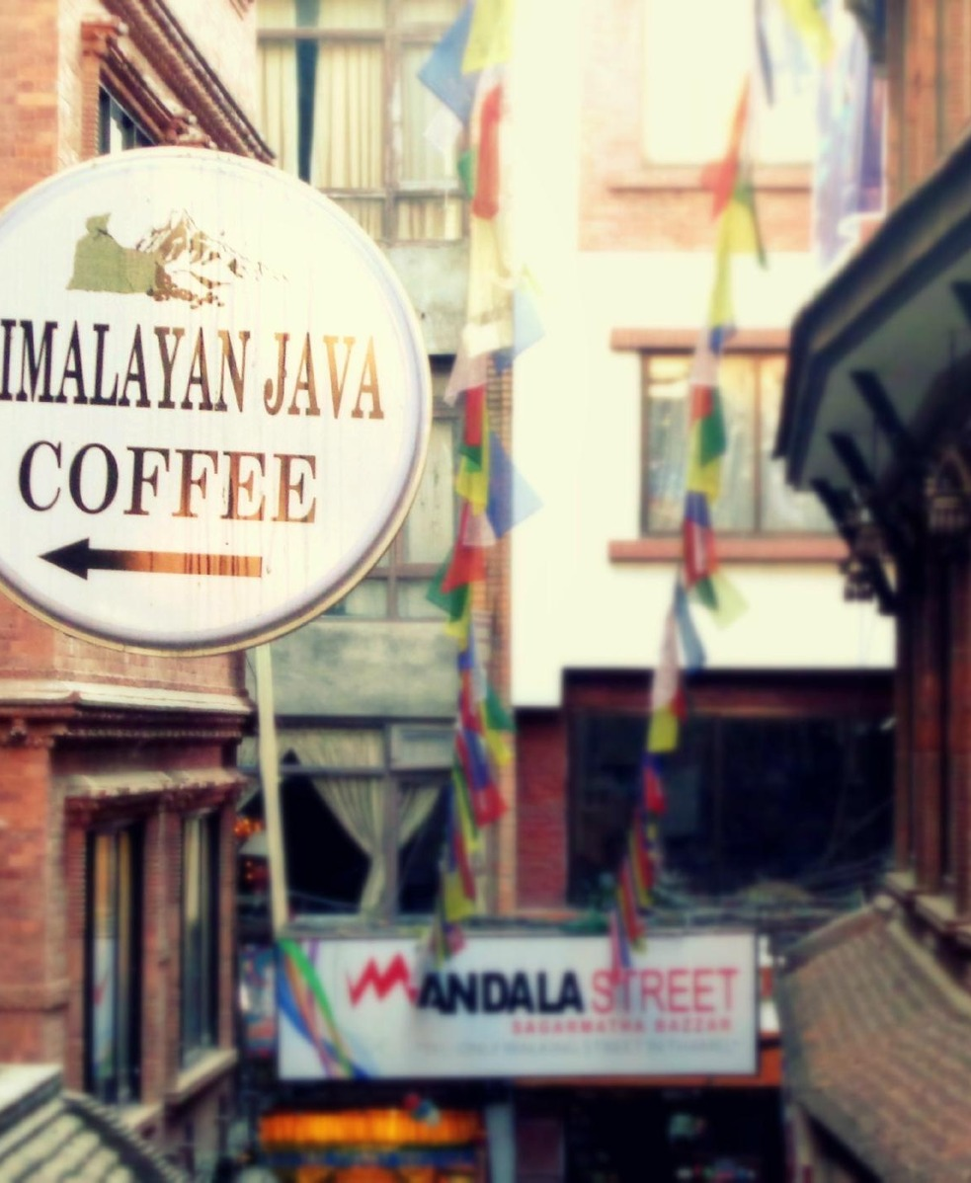


Introduction
This section introduces Himalayan Java, outlines the specialty coffee industry in Nepal and explains the purpose and scope of the report.
1.1 Background of the Selected Company
Himalayan Java is a Nepalese coffee brand established in 1999. According to its official website, the company began as Nepal’s first specialty coffee shop and played aThisn important role in introducing specialty coffee and third-wave coffee culture to the Nepalese market (Himalayan Java, n.d.).
The business was established with the objective of providing quality coffee while promoting Nepalese coffee and supporting the development of the domestic coffee industry.The introduction of Himalayan Java Express also demonstrates the brand’s efforts to respond to changing consumer lifestyles and demand for convenient service (Himalayan Java, n.d.).
The company has therefore established a recognisable position in Nepal’s specialty coffee market through its brand identity, product quality and café experience.

Slide 4

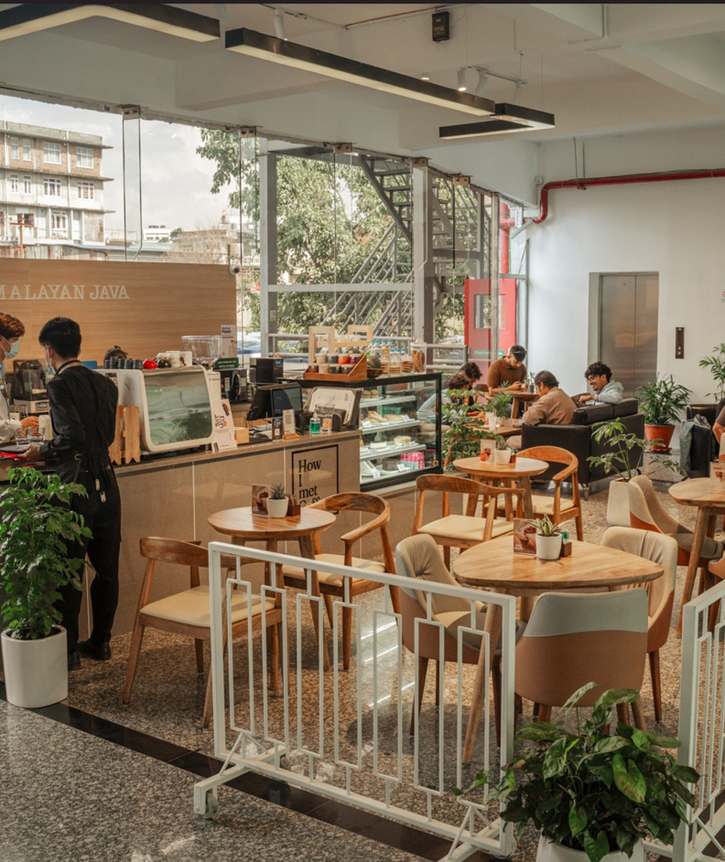


1.2 Industry Overview
The coffee industry in Nepal has experienced noticeable development as consumer preferences and urban lifestyles have changed. Although tea has traditionally been a major part of Nepalese consumption habits, coffee has increasingly become popular, particularly among younger consumers, students, professionals and urban residents.
Coffee shops are now used not only for purchasing beverages but also for socialising, studying, working and conducting informal business meetings. This has contributed to the growth of café culture, particularly in Kathmandu Valley and other urban areas (Onta, 2026). Nepal also has favourable geographical and climatic conditions for growing Arabica coffee in its hilly regions.

Slide 5



1.3 Purpose of the Report
The purpose of this report is to critically examine the current marketing plan of Himalayan Java, focusing specifically on its specialty coffee beverages sold through its cafés in Nepal.
Furthermore, the report aims to recommend appropriate marketing strategies based on the four elements of the marketing mix: product, price, place and promotion.
Particular attention is given to digital marketing, customer relationship management and loyalty-building activities.

Slide 6


Company overview
Himalayan Java was set up in 1999 and is a specialty coffee company. It started as the first specialty coffee shop in Nepal and gave customers a new kind of coffee experience. They helped start a café culture in Nepal and got people interested in specialty coffee.
Since starting as a small Coffee Shop they have expanded into a well-known brand with branches throughout Nepal and internationally through franchise.
They have expanded greatly due to increasing awareness of coffee and supporting the local coffee industry. They also aim to promote entrepreneurship.

Slide 7
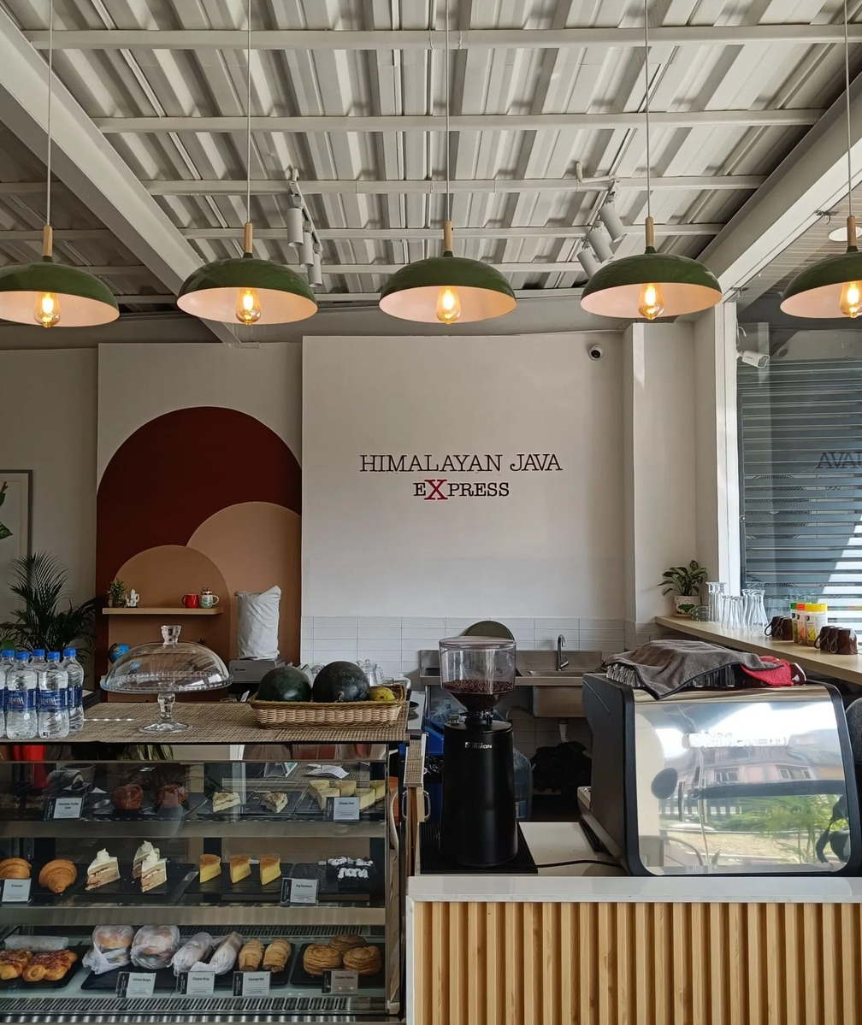


The key products of Himalayan Java are specialty coffee drinks.
They sell Espresso, Cappuccino, Latte, Americano and other hot and cold drinks.
They also sell coffee beans and pre-brewed coffee.
They also sell baked goods and snacks.
The Himalayan Java Express concept allows them to offer quick coffee service. This means they can offer a range of products to suit different customers whether they are a regular coffee lover or want somewhere to relax, study or catch up with friends.

Slide 8


This target market are mainly coffee lovers and café enthusiasts. They have identified their key audiences as University students, Young Adults, Working Professionals, Tourists and MiddleTheir Income individuals who are willing to spend on quality coffee and a nice atmosphere. They visit cafes to socialise, meet, study, work or just to have some fun. (Marketing Analysis) With the increase of café culture in the cities of Nepal they have opportunities to attract new customers and coffee lovers.
Himalayan Java currently have marketing strategies to position themselves as a specialty coffee company. Their cafés offer specialty coffee and coffee/ café experiences. This makes them stand out from regular drink sellers. They have a café which allows them to interact with customers and increases brand awareness due to the great service and nice atmosphere..

Slide 9

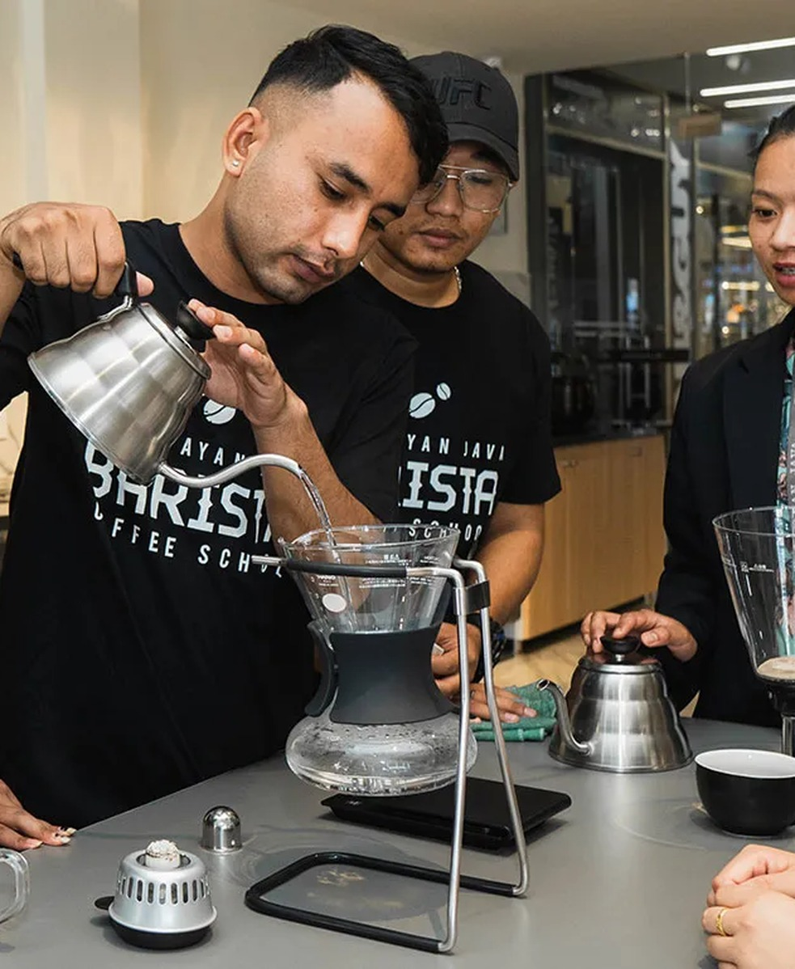
They have a website and social media to inform customers about their brand, products and branch. Their franchise and express concept allows them to reach a larger market. Overall this keeps them in the growing specialty coffee market in Nepal. However by focusing more on interaction with customers, increasing customer loyalty and offering quality service they will gain an advantage
Overall Himalayan Java are still a part of the specialty coffee scene in Nepal. Due to having a strong brand, quality products, friendly cafes and growing presence. By sticking to their values of quality, community and responsibility they can continue to grow and inspire coffee lovers

Slide 10

Market Opportunity Analysis
This section provides an analysis of the markets in which Himalayan Java operate. Opportunities and challenges within the market are identified using a SWOT analysis to highlight the businesses strengths, weaknesses, opportunities and threats. This analysis will look at the specialty coffee drinks offered by Himalayan Java.
3.1 External Environment
The coffee market in Nepal has been growing due to an increase in popularity.
In urban areas such as Kathmandu, cafes are becoming very popular places to purchase drinks.
As well as purchasing drinks, they have become a place to socialise, study and work.

Slide 11
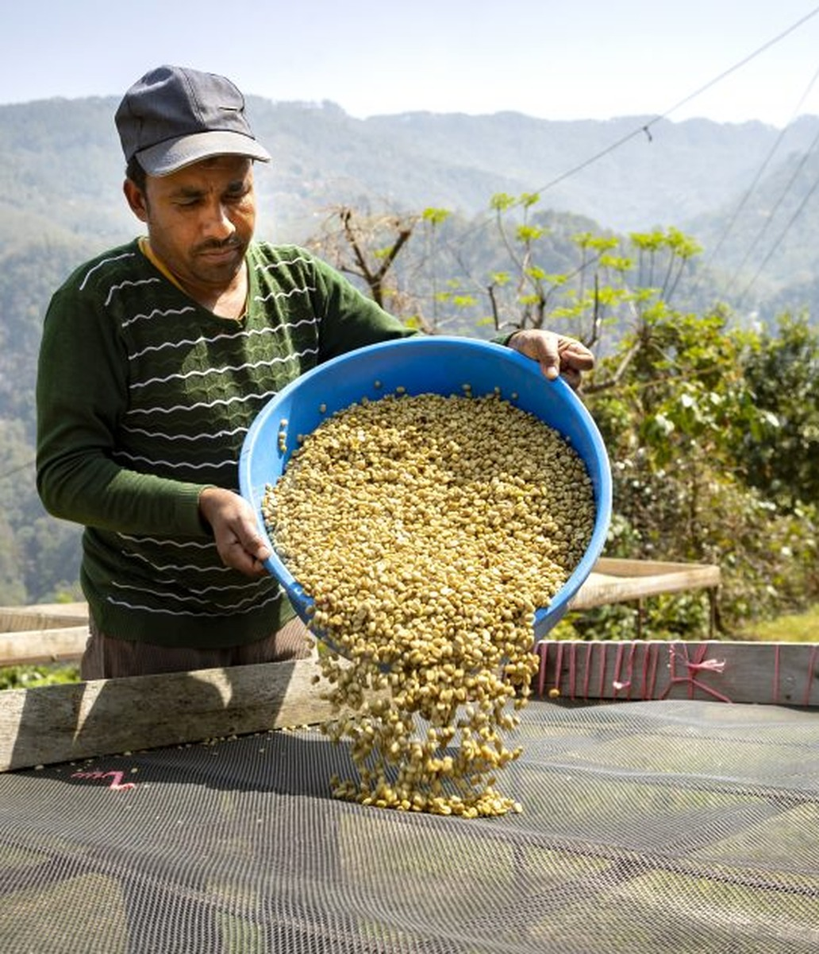
Coffee can be grown in suitable areas of the mid-hills. Arabica Coffee can be grown due to the right altitude and climate.H owever, there are challenges within the domestic coffee sector such as low productivity, low quality, poor processing, poor infrastructure and small scale production.
This can lead to low and inconsistent quality of coffee available domestically. (Tuladhar and Khanal, 2020)
This means opportunities exist for Himalayan Java to form good relationships with local farmers.

Slide 12


According to Nepal News there was an import of 203,000kg of coffee valued at around NPR 144.1 million in the 2024/25 year. (Rai, 2026)
This shows there is still a level of reliance on imports. However, Himalayan Java can gradually move to using more locally sourced beans if the quality and quantity are right.
Offering digital marketing, online ordering, contactless payments and loyalty schemes can help Himalayan Java attract customers and encourage them to purchase regularly. However, there is competition from sole trader cafes, other well known brands and other drink.

Slide 13
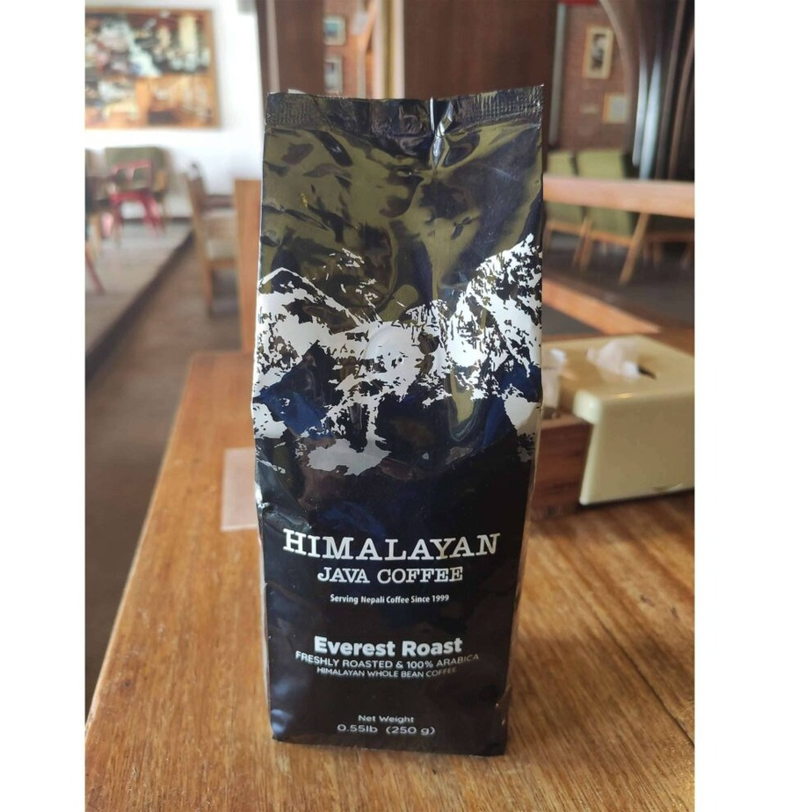
3.2 SWOT Analysis
A SWOT analysis is a strategy tool used to assess the strength and weakness of a company as well as identifying the opportunities and threats facing the business.
Strengths:
Recognisable brand – Having created the brand in 1999, the brand name has become recognisable in Nepal’s specialty coffee market. Having been around for so long gives the company lots of experience.
Variety – They sell a variety of coffees, pre-packaged coffee, baked goods and snacks. This means they can appeal to a variety of customers.

Slide 14
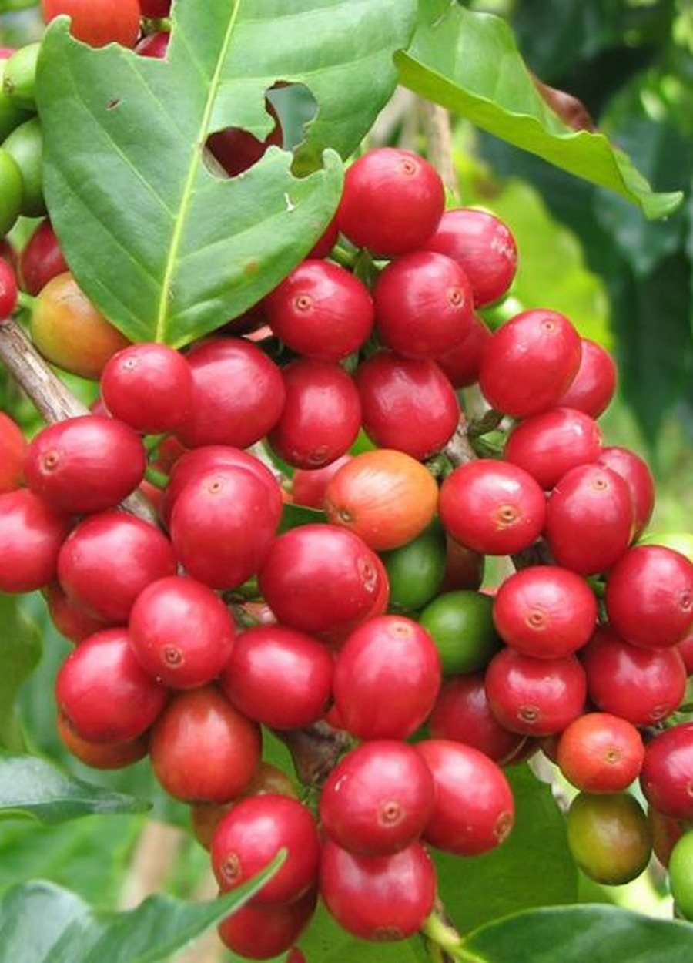
Weaknesses | Opportunities
High Prices – Due to their high end café, they may have higher prices than typical tea shops and small coffee shops. This may be unaffordable for students. | Growing Interest – Due to growing interest in specialty coffee and café’s in Nepal, there is an opportunity to attract new customers and boost sales.
High Costs – Running café’s can be costly due to the high costs of rent, staff wages, coffee machines, ingredients, electricity and maintenance. | Local Farmers – They can build better relationships with local coffee farmers in Nepal and slowly increase the amount of local coffee they use.

Slide 15


Threats
Competition – There is a lot of competition from independent cafés, local coffee shops and international coffee brands. Customers have lots of options.
Coffee Production – There isn’t enough coffee being produced locally, there could be issues with farming and inconsistency of quality.
Inflation – Prices of ingredients, rent, delivery and electricity could increase meaning the costs of running the business could increase. Inflation means customers have less money to spend meaning they may not want to spend on high end coffee.
Changing Trends – Customers may not want to buy café products and want to drink tea, energy drinks, instant coffee or make their own.

Slide 16
3.3 Interpretation of SWOT
Strengths: | Weaknesses
▪ Recognisable brand ▪ Variety | ▪ High Prices ▪ High Costs
Opportunities | Threats
▪ Growing Interest ▪ Local Farmers | ▪ Competition ▪ Coffee Production ▪ Inflation ▪ Changing Trends
Overall the SWOT analysis shows that Himalayan Java has a strong base as they have a recognisable brand, they specialise in coffee and are part of Nepal’s growing café culture.
However, they may face issues due to their high prices, costs and coffee supply. The most promising opportunity they have is to work with local farmers to promote local coffee, expand their social media marketing and loyalty schemes.
Overall they can use their strengths to take advantage of the opportunities in the market and overcome their weaknesses to become more competitive and have sustainable growth.

Slide 17


Marketing Mix Strategy Recommendations
. Marketing Mix Strategy Recommendation
After completing a SWOT analysis there are several recommendations on marketing strategies that Himalayan Java should implement in the specialty coffee industry in Nepal in order to become more competitive. These recommendations are centred on the 4Ps of marketing; product, price, place and promotion. Ultimately they aim to gain new customers, increase customer satisfaction and drive customer loyalty. This will drive up profits in the long run.
product
price
place
promotion

Slide 18

4.1 Product Strategy
Himalayan Java should invest into their product to innovate, improve quality and differentiate. They should strive to create new drinks from using local Nepalese coffee with regards to quality and availability. For example special drinks using coffee from places like Gulmi, Palpa and other coffee growing areas.
They should diversify their product offering to include seasonal drinks, ice coffees, low sugar and plant based milks. This will appeal to health conscious customers. Additionally they may want to offer cheap coffee and snack combo’s to students and professionals.
Quality of product should be standardised across all outlets. This should be achieved through having standardised recipes, staff training, quality checks on the ingredients and customer feedback.
Eye catching eco friendly packaging could help the brand image especially for takeaways and packed coffee.

Slide 19

4.2 Price Strategy
Price Strategy
A competitive price and value-based strategy should be taken. Due to the positioning of the brand in the specialty coffee market, the prices should reflect the quality of the coffee, service, convenience and whole café experience.
Incentives such as discounts for students and offering low priced coffee with a snack will appeal to people looking for cheap prices without compromising the value of the brand.
Bundling should be used as well, therefore offering a cappuccino along with an item from the bakery at a reduced price. This may increase the average spend, therefore encouraging customers to buy more items.

Slide 20
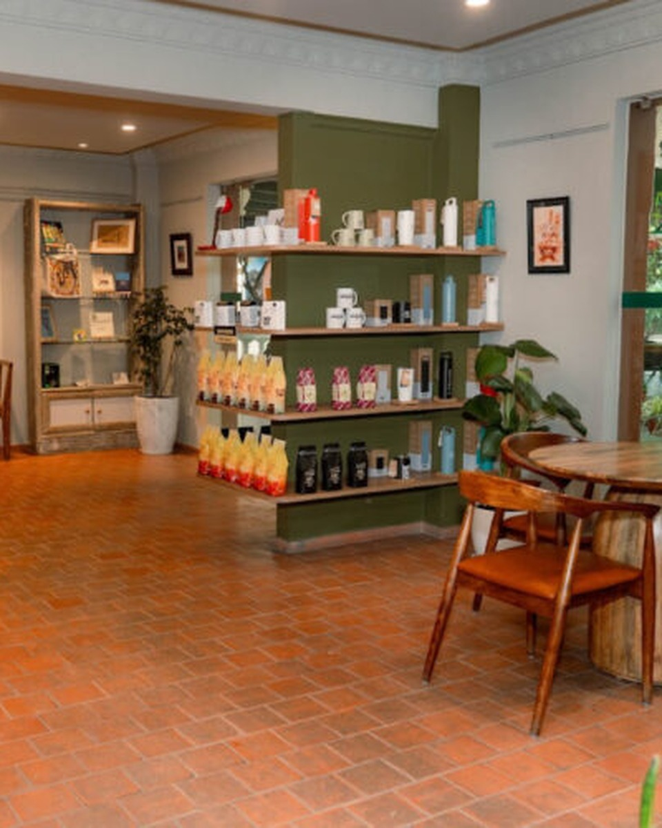
4.3 Place (Distribution) Strategy
Place
Himalayan Java should improve its distribution channels in order to make products more accessible.
The current cafes should still be the core distribution method for customers to gain direct access to the beverages, foods and whole experience.
The company can use Himalayan Java Express to target quick service and takeaway customers.
Coffee beans and ground coffee can be distributed through selected supermarkets, retail stores and online. This will enable the brand to target those who would prefer to make their coffee at home.

Slide 21


4.4 Promotion Strategy
A combination of advertising, social media and sales promotions should be used to promote and raise brand awareness.
Advertising Targeted advertising will be implemented to highlight the quality of the products, identity as Nepalese coffee and experience at the café.
Digital adverts can advertise to potential customers in the area surrounding the outlets using Google, Facebook and Instagram. Promotional campaigns can be run to showcase new drink offerings, seasonal items, promotions and locally sourced coffees.
Additionally, outdoor advertising can be done through posters and displays to raise brand awareness in local areas around universities, shopping centres and offices

Slide 22

4.5 Expected Outcomes
The suggested 4P strategies will increase Himalayan Java’s market position as they improve product range, price options, convenience of distribution and customer relationships.
Using a mixture of local promotion, online engagement and loyalty benefits can lead to increased customer repurchase, increased lifetime value and long-term profitability.
The suggestions take into account the importance of aligning marketing mixes to create customer value and deliver business objectives (Kotler, Keller & Chernev, 2022).

Slide 23
conclusion
The analysis has shown that Himalayan Java is a well-known specialty coffee brand in Nepal. It has helped develop the specialty coffee culture in Nepal since it was founded in 1999. This gives them many advantages including brand awareness, being a specialty coffee brand, variety of products and being associated with coffee in Nepal.
Looking at the market opportunity, there are many opportunities for Himalayan Java. As coffee and café culture has become popular in Nepal they can target new customers such as students, young adults and professionals. The growth of interest in specialty drinks and digital media also allows the company to innovate their products.
However there are some challenges they face such as competitors from independent café brands, increased costs, not much domestic coffee production and changing consumer preferences. Opportunities to improve include making their products more affordable, providing good quality service and building good sourcing relationships.

Slide 24
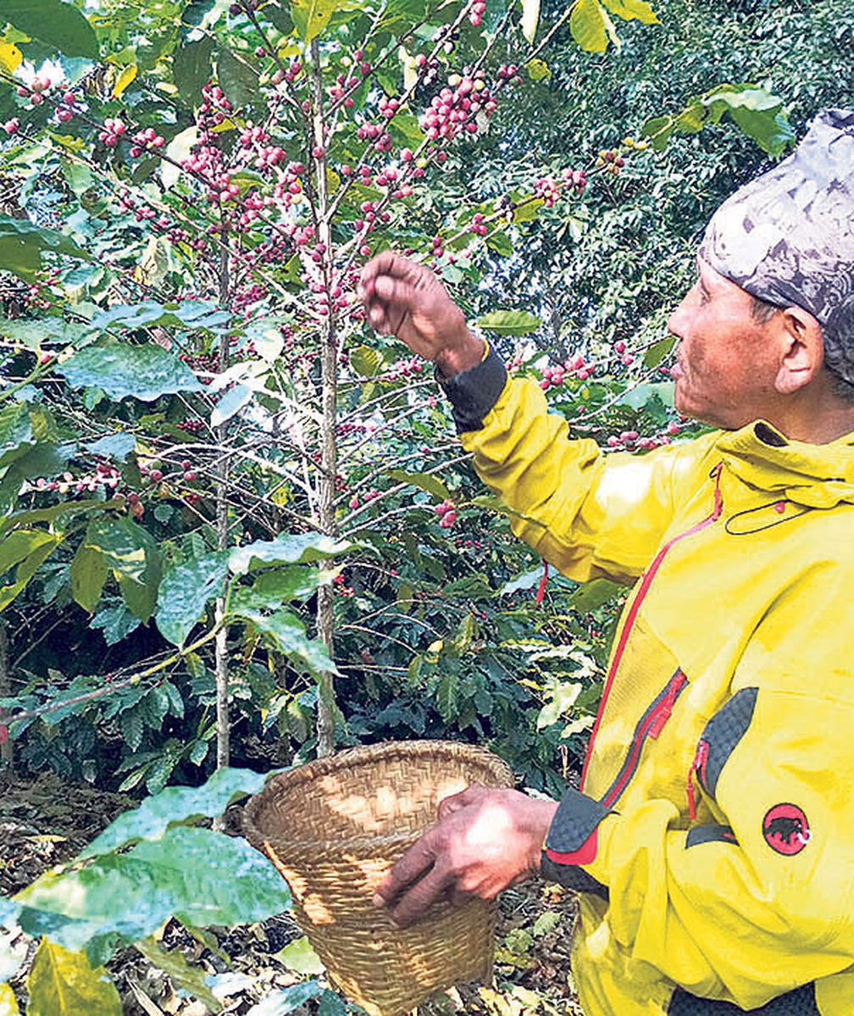
Overall Himalayan Java has lots of potential to improve their position within the growing specialty coffee market in Nepal. By focusing on product innovation, competitive pricing, easy access and effective promotions they can overcome challenges in the market and changing customer expectations.
If these recommendations are implemented successfully it can improve customer satisfaction, brand loyalty, increase competitiveness and help them grow sustainably.

Slide 25
references

